Slide 1
Environmental Justice Concerns: Places, People, Benefits
Trisha Kehaulani Watson, J.D., Ph.D.
Honua Consulting
Updated April 2019

Slide 2
Environmental Justice, Energy Justice, and Climate Justice
Environmental Justice is the social movement whereby peoples of all origins, incomes, and classes receive fair treatment and opportunity to meaningfully engage in decisions related to environmental policies that impact their living conditions, lives, and surrounding environment.
Energy Justice is an emerging field and movement that applies an environmental justice framework to issues related to energy, including but not limited to how people, particularly marginalized communities, are impacted by energy development, infrastructure, and initiatives.
Climate Justice is the growing global social movement that frames issues related to global warming and climate change within a justice framework, demanding consideration for how grassroots and marginalized communities are impacted by climate issues, including climate change solutions.

Slide 3
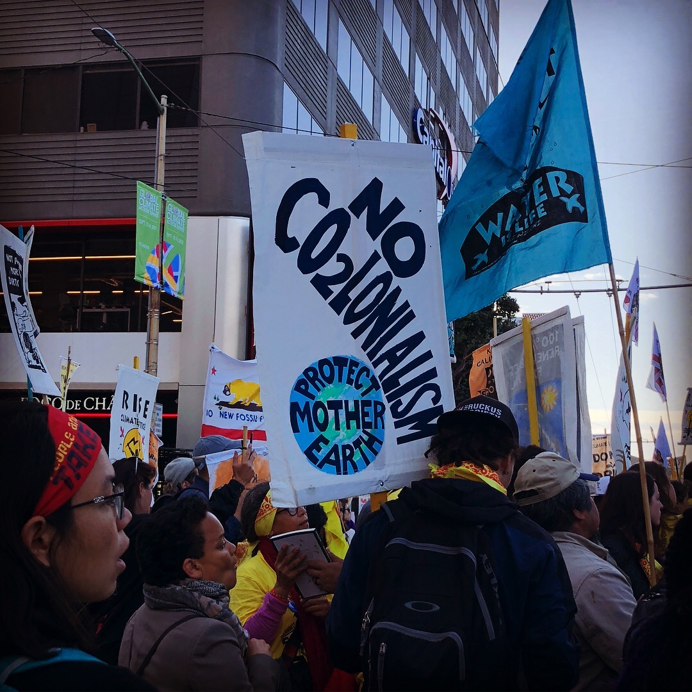
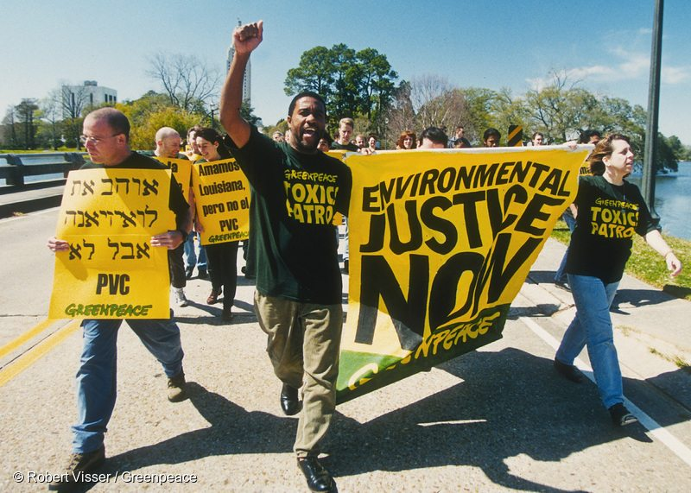
From Environmental Justice to Climate Justice
Photo Credit: Greenpeace

Slide 4
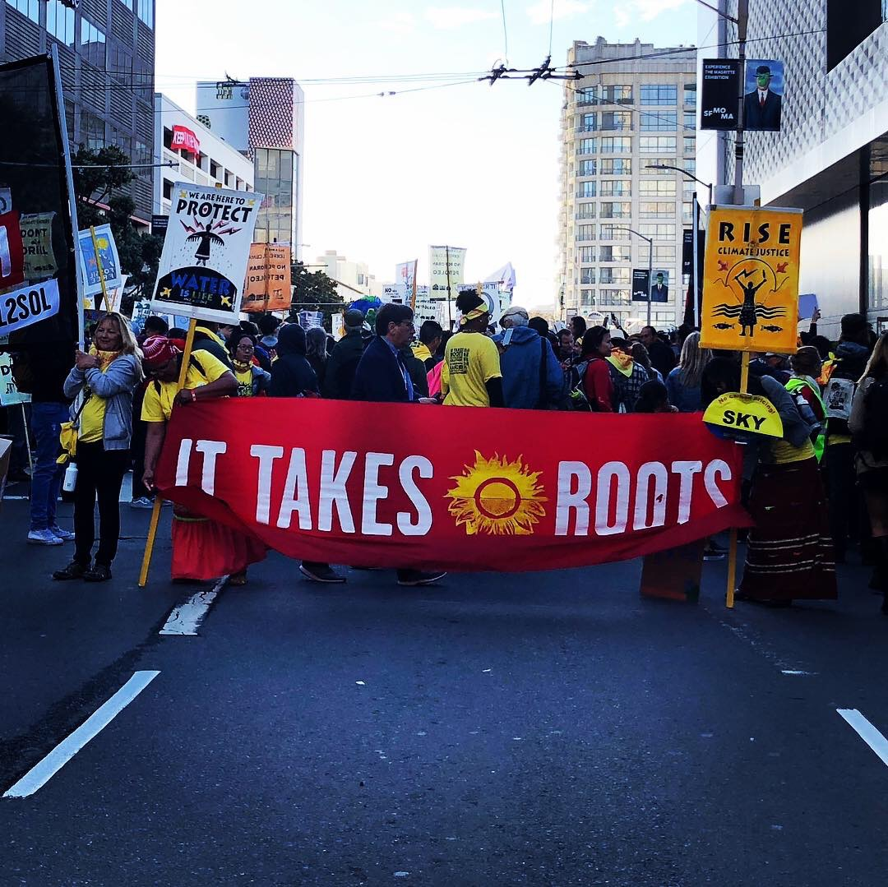
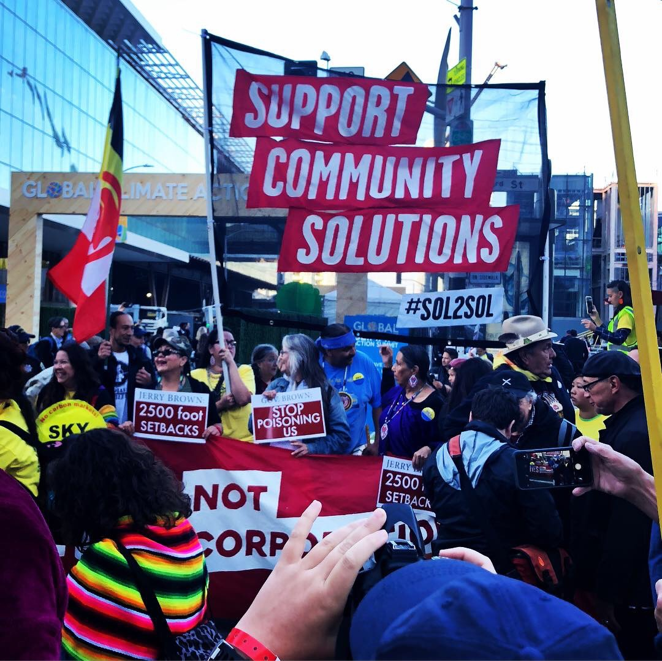
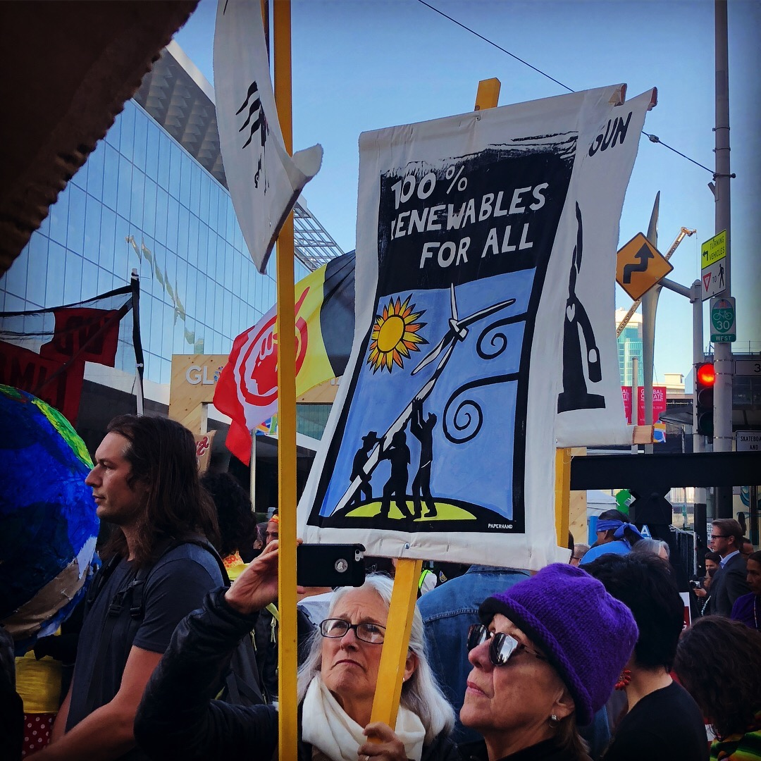
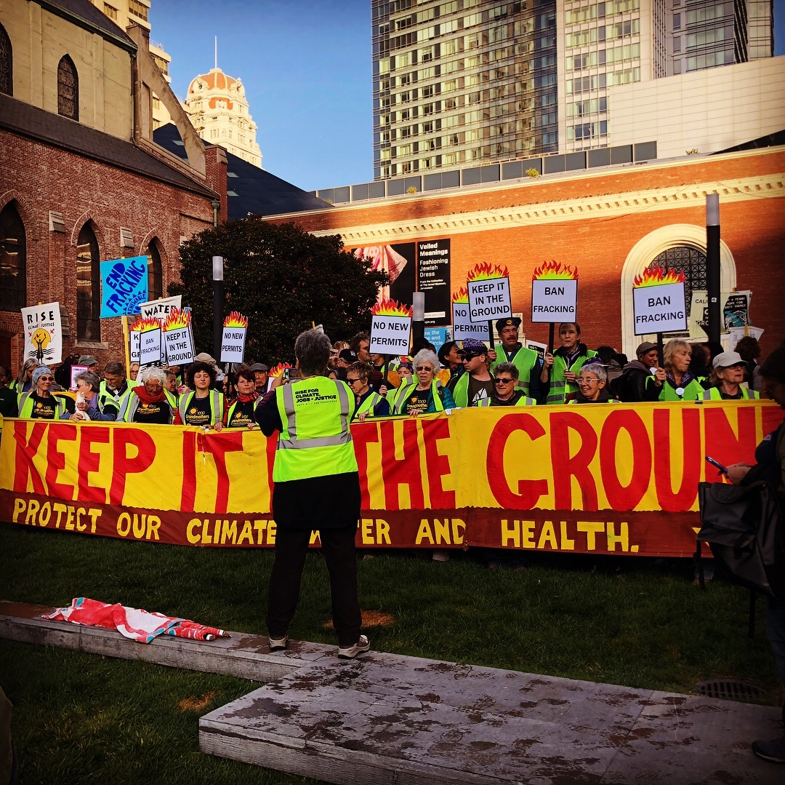

Slide 5
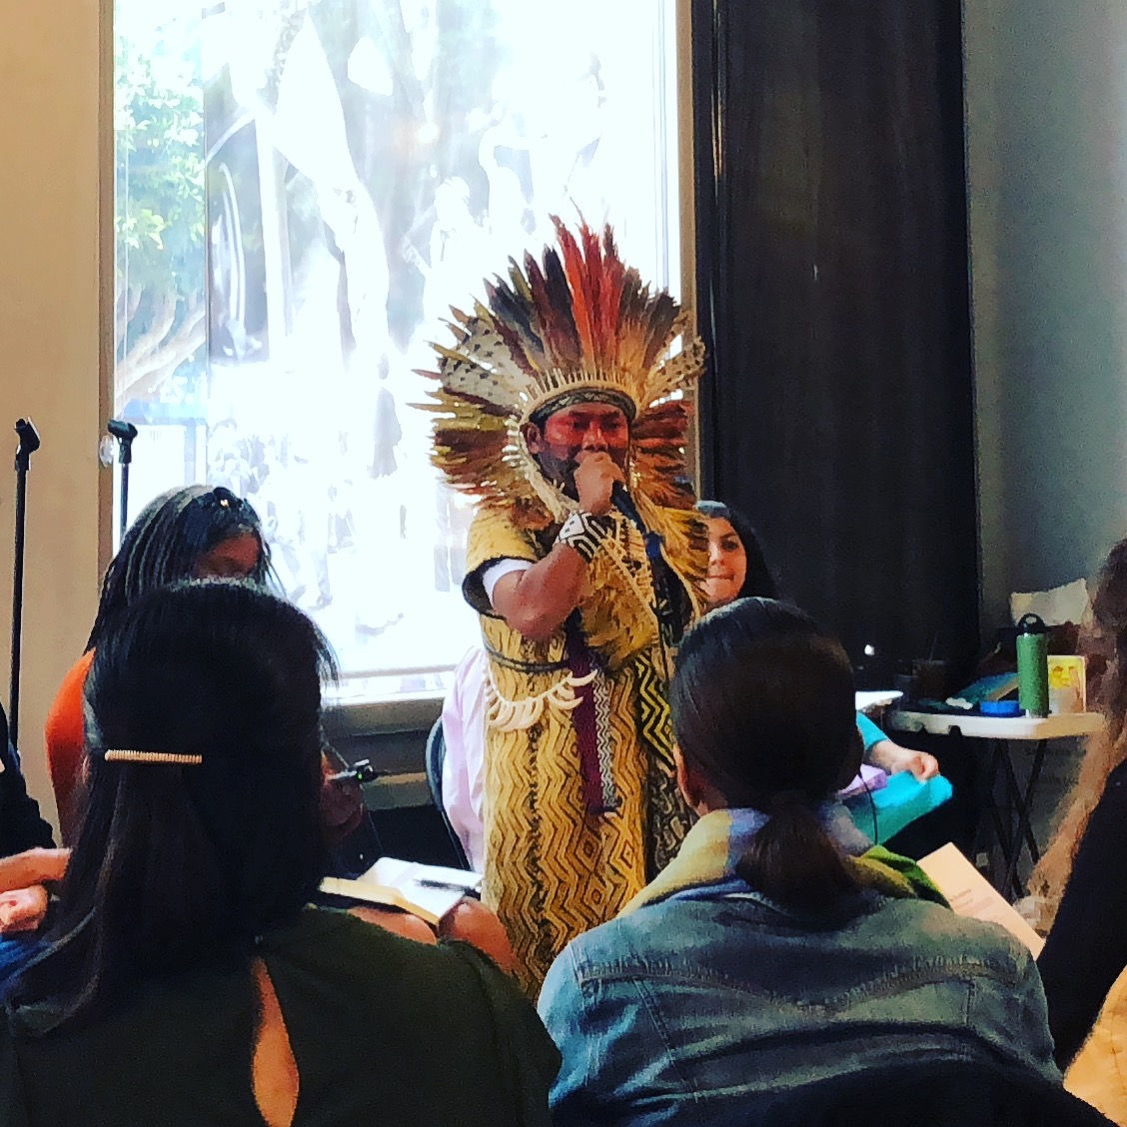

Slide 6
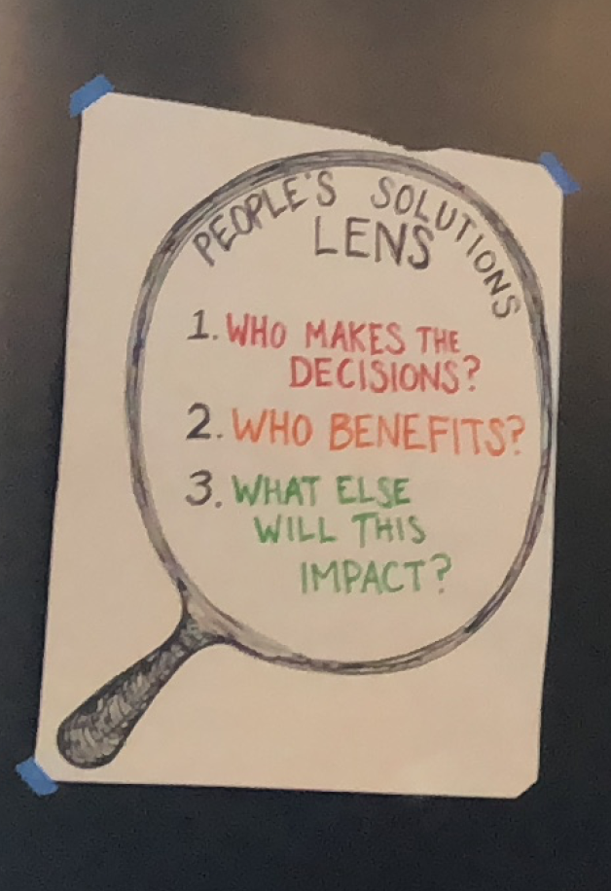
People’s Solutions LENS
Who makes the decisions?
Who benefits?
What else will this impact?

